Slide 1


Slide 2
Jan-Christoph Borchardt
@fsfe.org
.wordpress.com
interface, usability & experience
jancborchardt

Slide 4
data synchronization
online & offline
access everywhere

Slide 5
minimal requirements
optional apps

Slide 6



+

Slide 7
PHP 5 & MySQL / SQLite
AGPL licensed

Slide 8
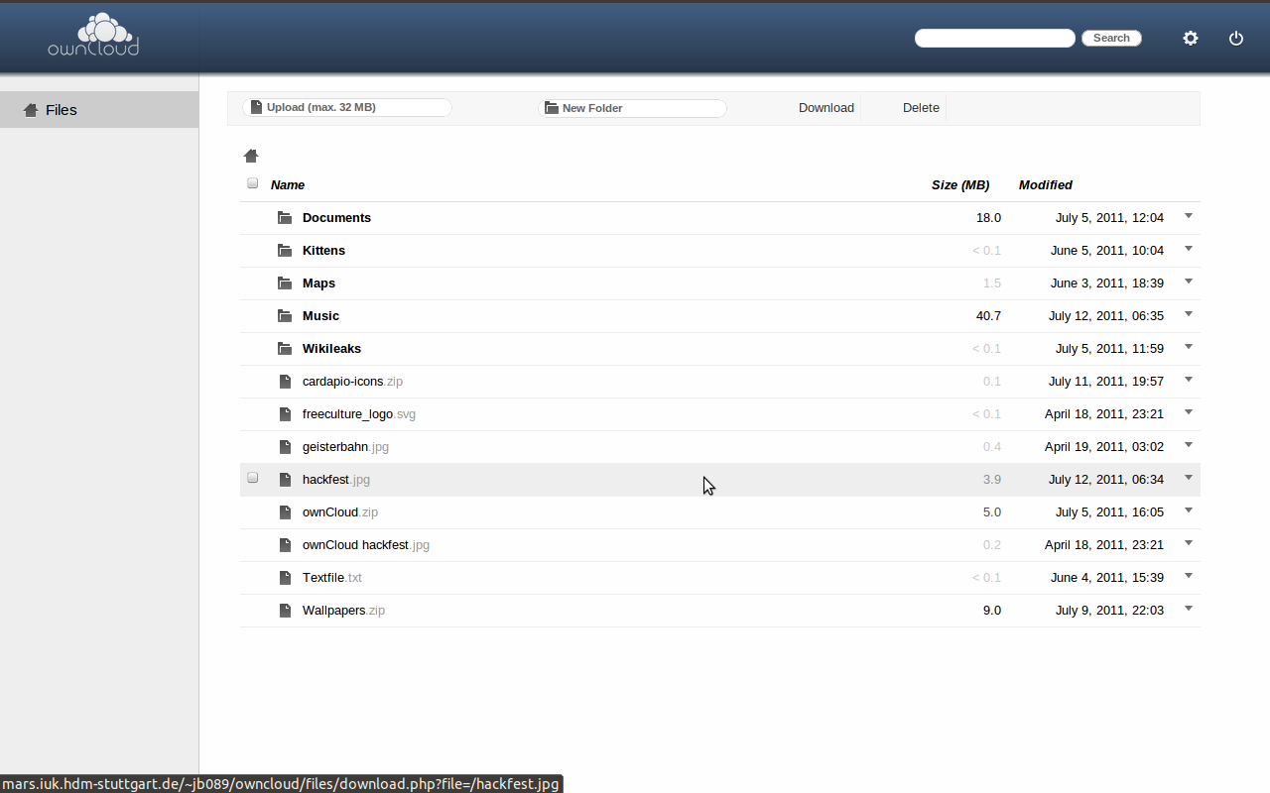

Slide 10
desktop apps → cloud apps

Slide 11
Advantages of cloud apps
ubiquitous presence
of applications and data
no worries about
losing work if your
machine crashes
no need to
install software
delegation of
updates & backups
to service provider
easy interaction & sharing with other people
access from everywhere (laptop, work, internet café, …)

Slide 12
Disadvantages of cloud apps
Where are your files stored?
In which legislation?
data might not be encrypted
dependency on infrastructure & net connection
hosting is nontrivial
safety of personal data & interaction
costs money
(premium features)

Slide 13
can we combine
the best of both worlds?

Slide 14
rich desktop apps
social
easily deployable
data under my control
accessible from every device

Slide 16
1 all data under my control

Slide 17
own server
home computer + PageKite
company server
ownCloud provider

Slide 18
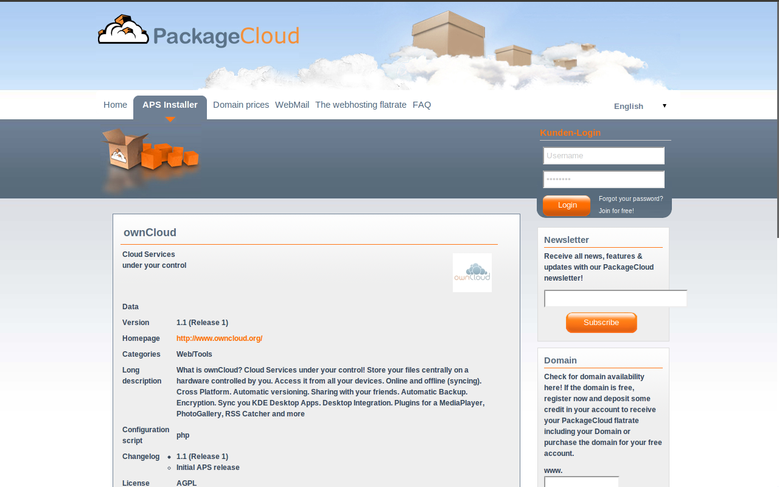

Slide 19


owncloud package

Slide 20
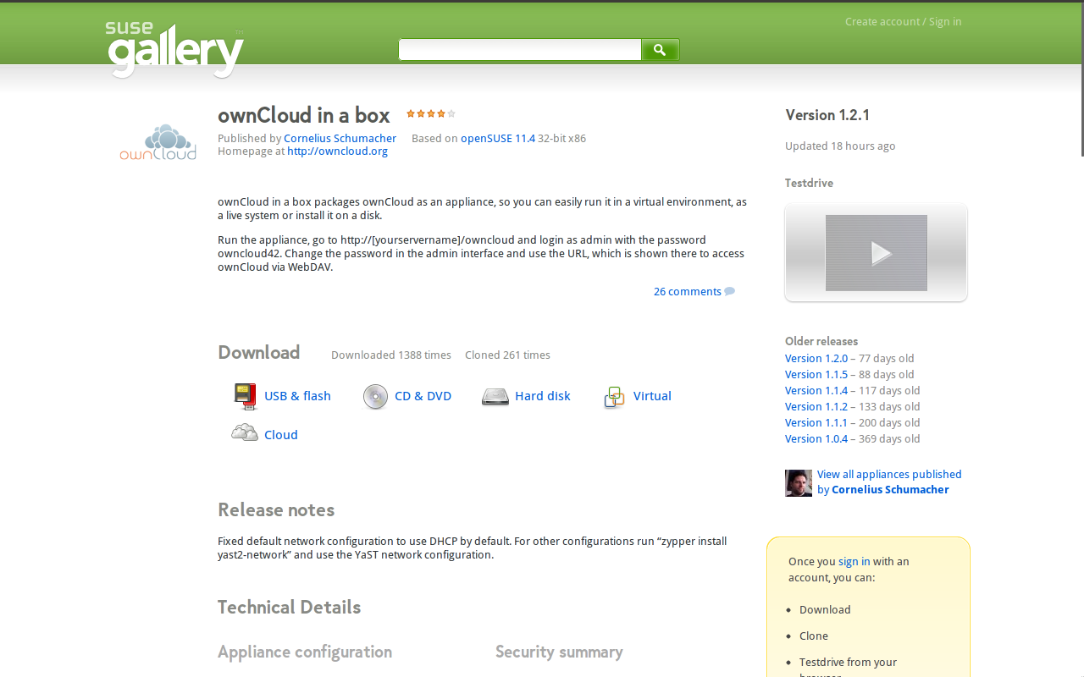

Slide 21
download
upload to your server
set permissions
finish installation

Slide 22
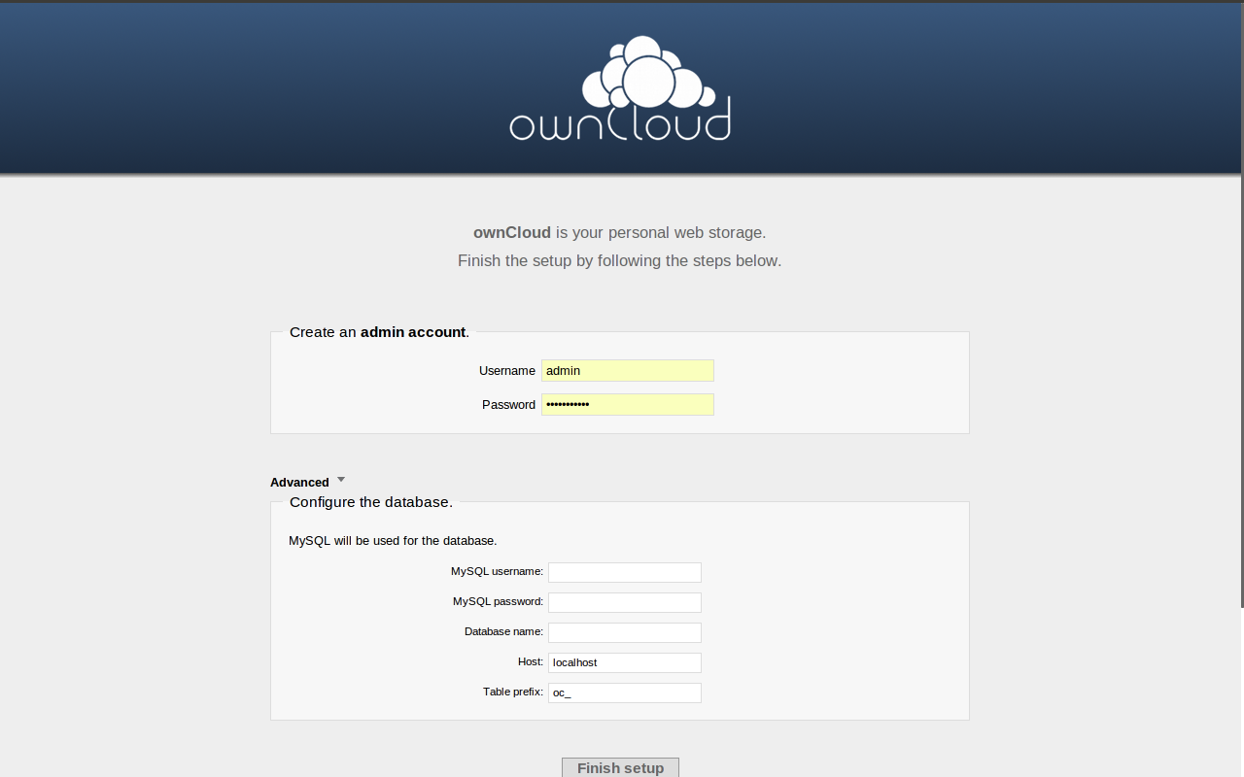

Slide 23
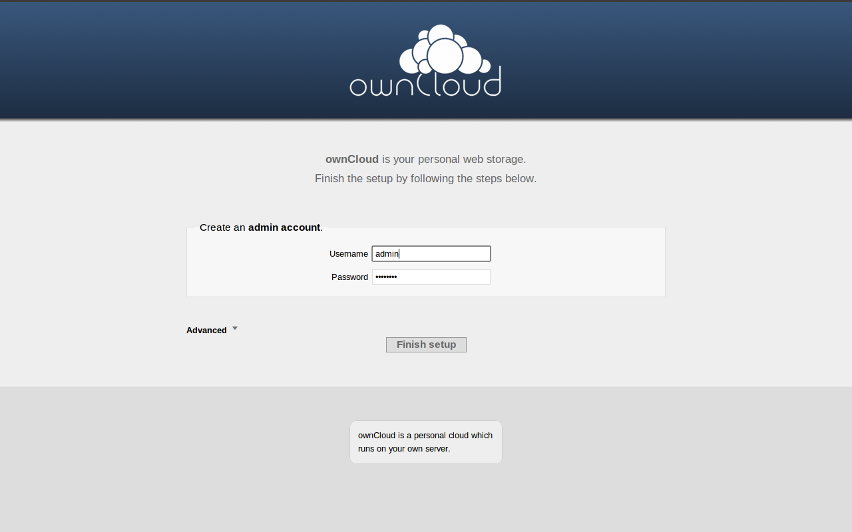

Slide 25
2 access from everywhere
and every device

Slide 26
web interface
Android & webOS apps in development
WebDAV

Slide 28
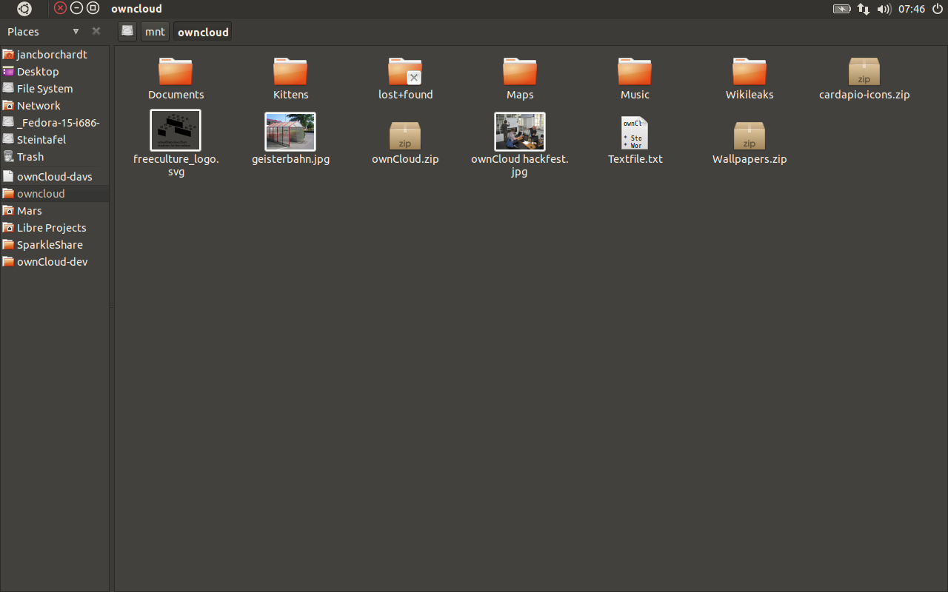

Slide 29
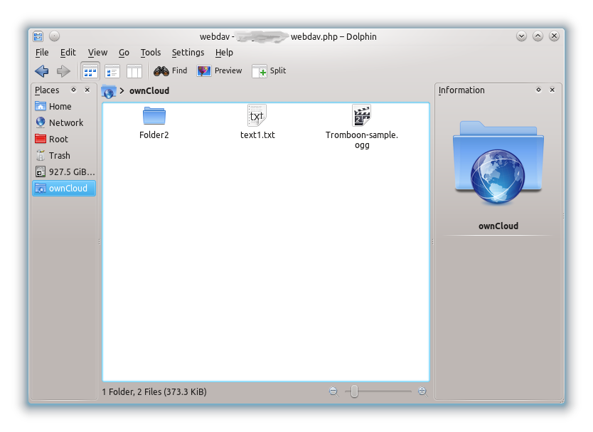

Slide 30
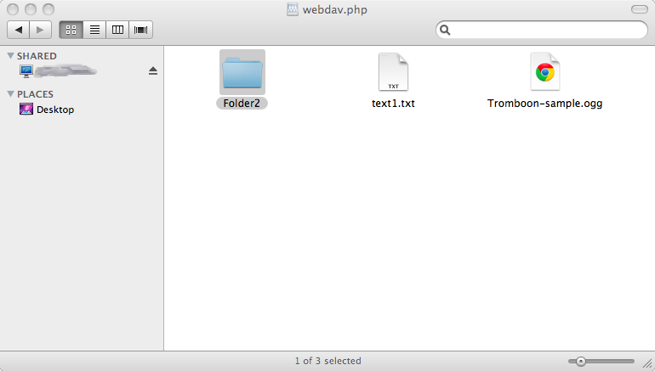

Slide 31
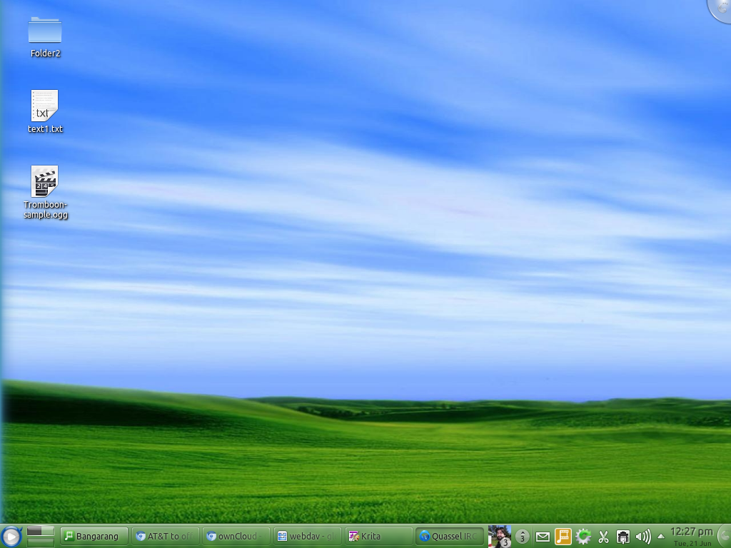

Slide 33
3 work on- & offline
4 automatic backup

Slide 34
desktop sync client with SyncML
in development

Slide 36
5 versioning & recovery
6 encryption
planned

Slide 38
7 easy sharing

Slide 39
public links
sharing with permissions in development

Slide 40
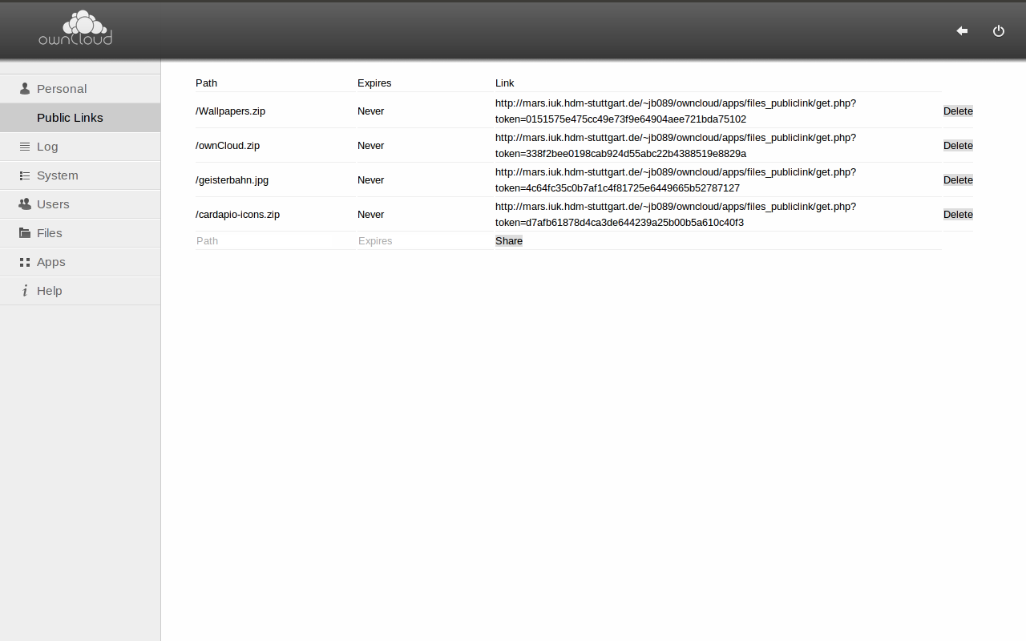

Slide 42
8 easily extendable storage

Slide 43
contacts .vcf
calendar .ical
…

Slide 44
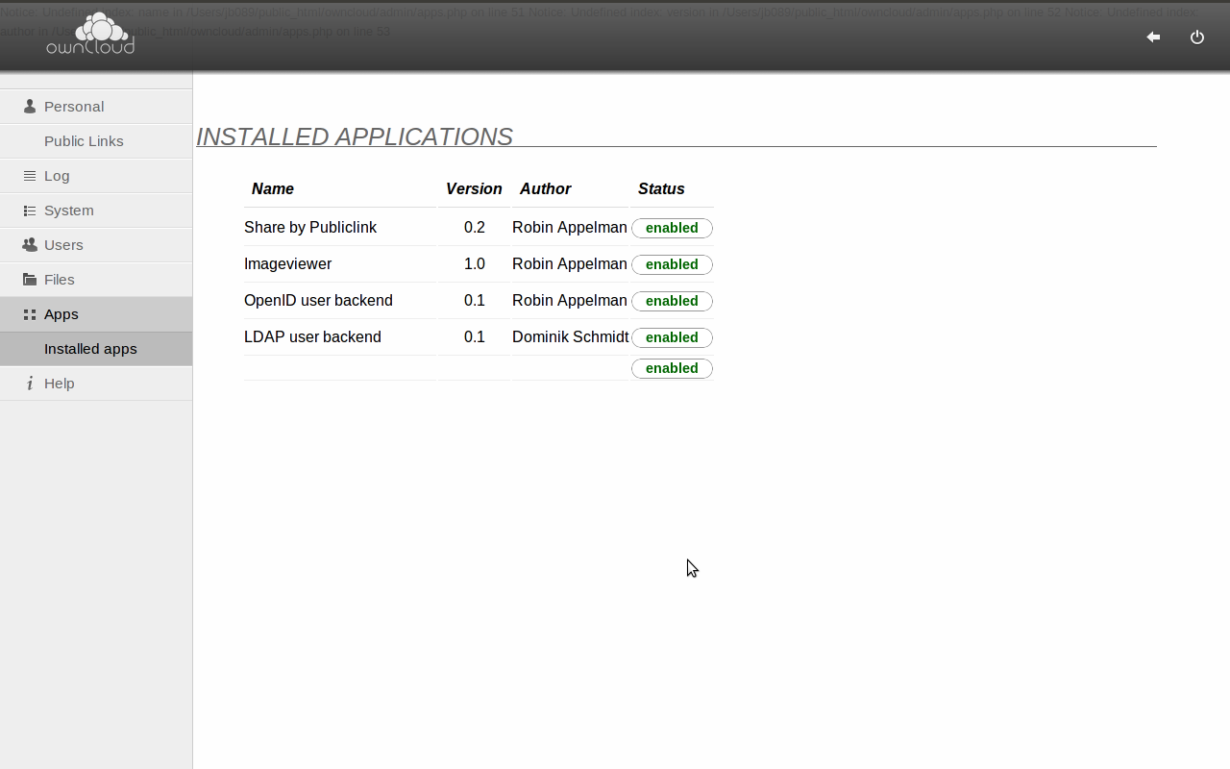

Slide 45
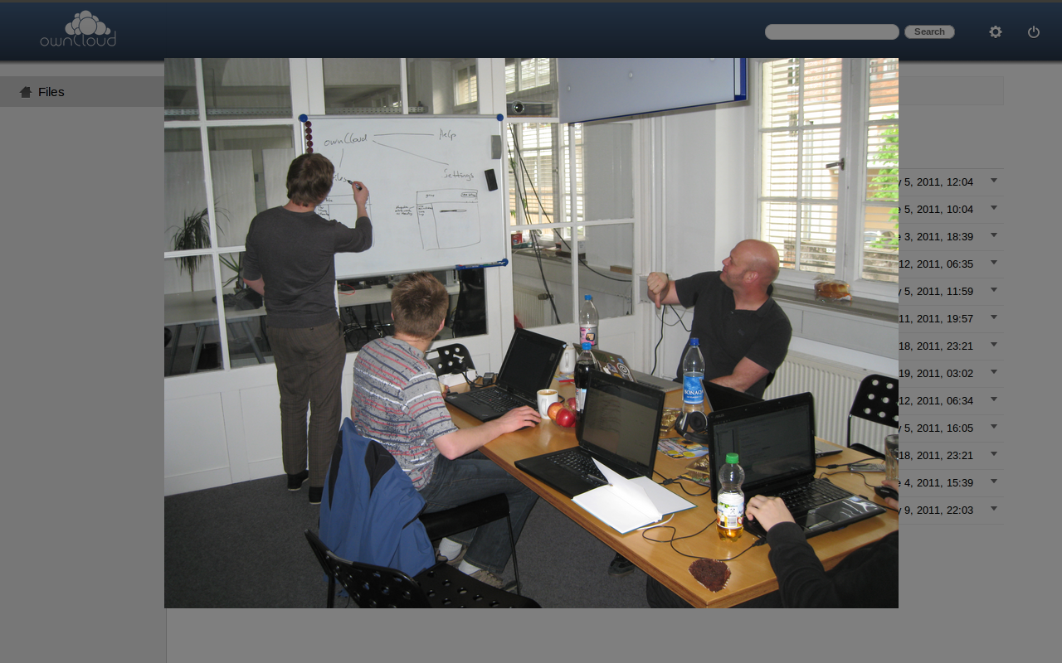

Slide 46
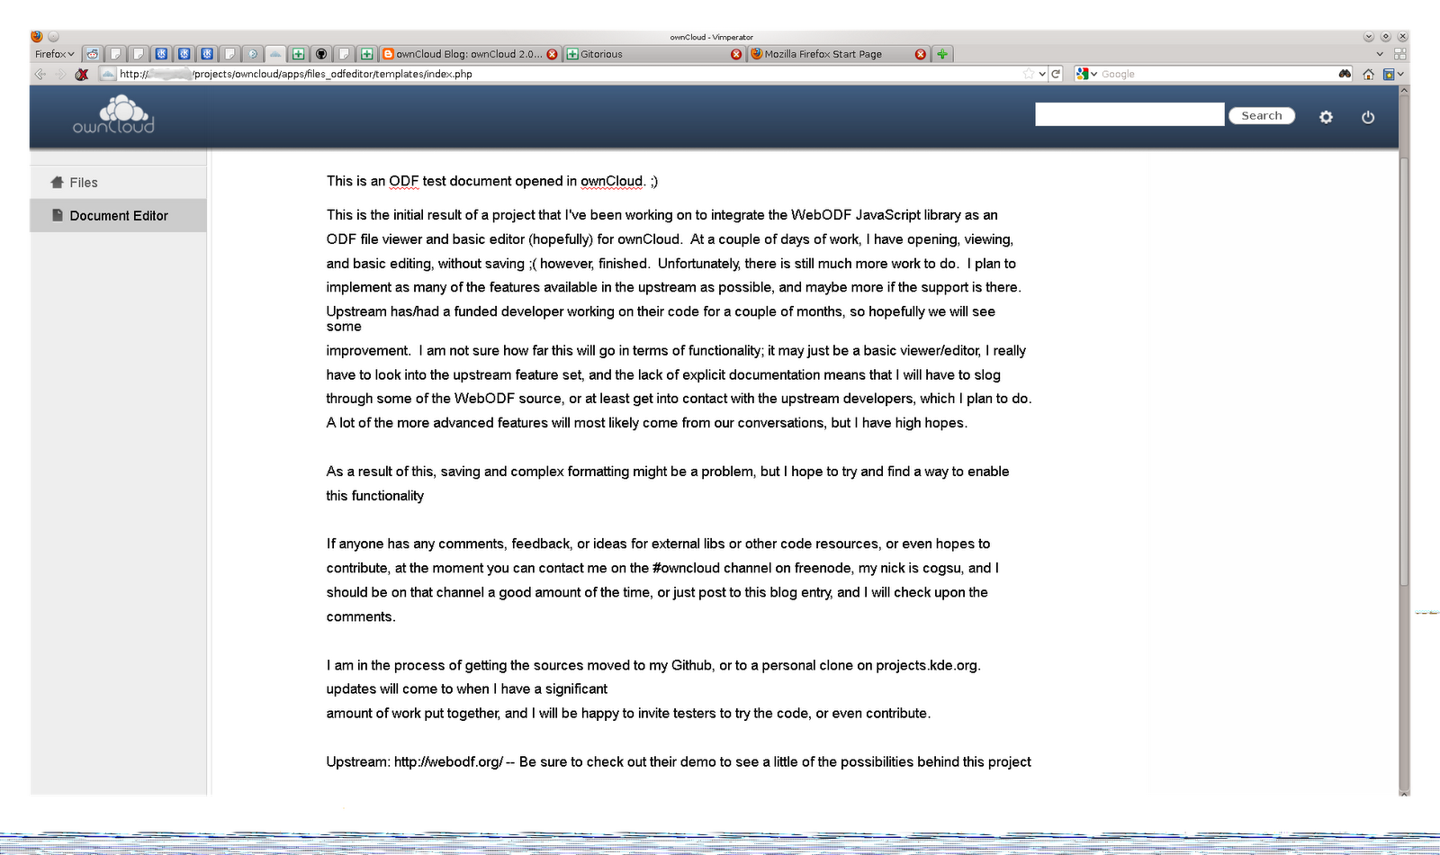

Slide 47
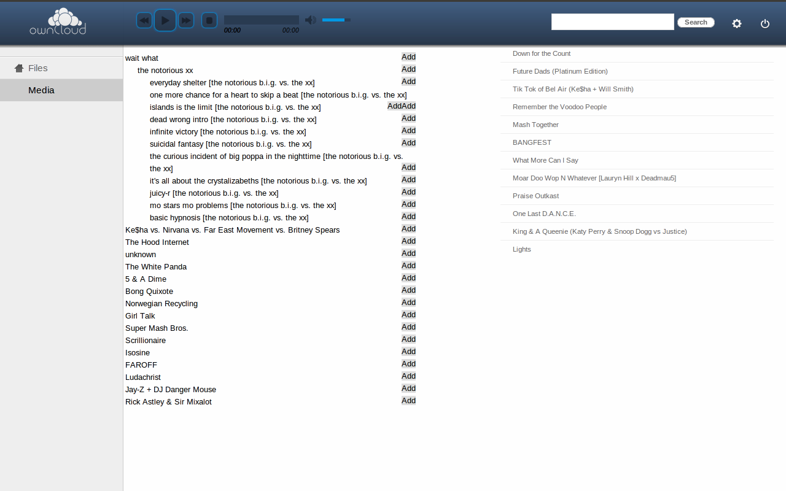

Slide 49

UNHOSTED

Slide 50
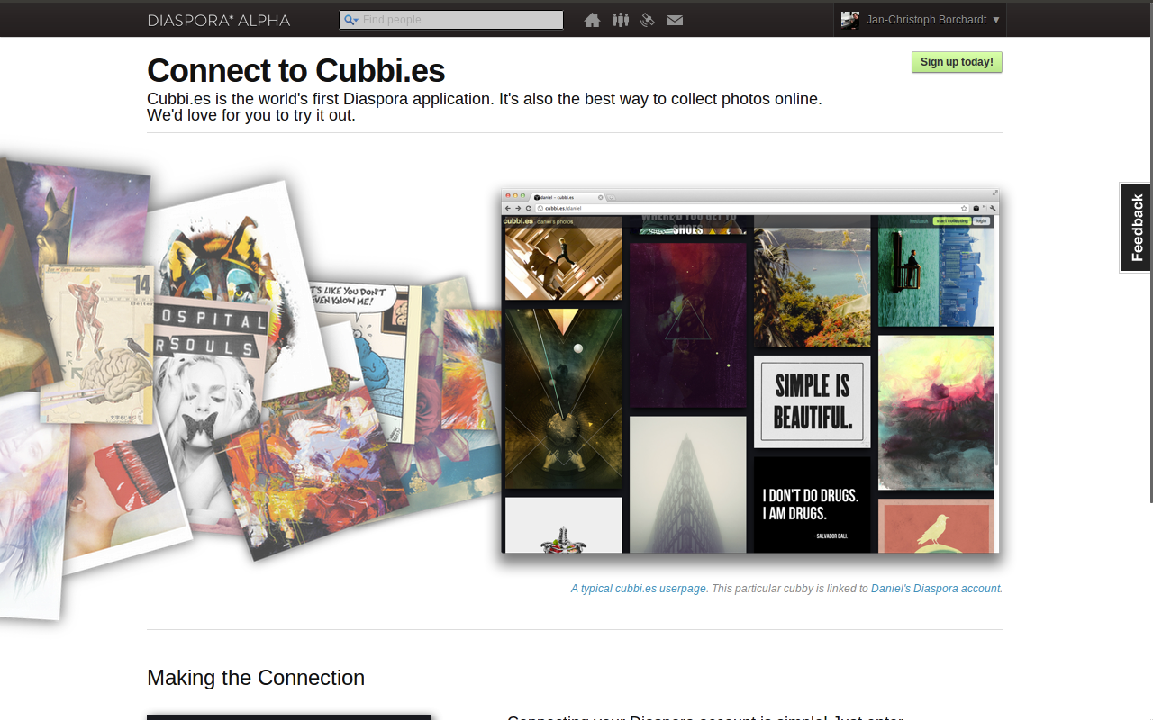

Slide 51
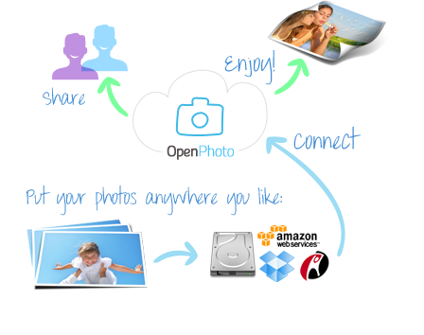

Slide 53
Try it
libreprojects.net/owncloud

Slide 54
Try it
Contribute
ownCloud.org
libreprojects.net/owncloud
git clone git://anongit.kde.org/owncloud
Jan-Christoph Borchardt
@fsfe.org
.wordpress.com
jancborchardt
typeface FreeSans some content by Frank Karlitschek, some screenshots by Aaron Reichman feel free to use & share CC-BY-SA

